Slide 1
Unity Platformer
Eric Tran, Jonathan Mai, Michael Chung, Justin Tang

Slide 2
Player Creation and Scripts
Created Player Scripts with ray aliasing for colliders
Player model with sprite and camera tracking
Projectile and Health script

Slide 3
Player Animations
Ready to be implemented into code but not yet done

Slide 4
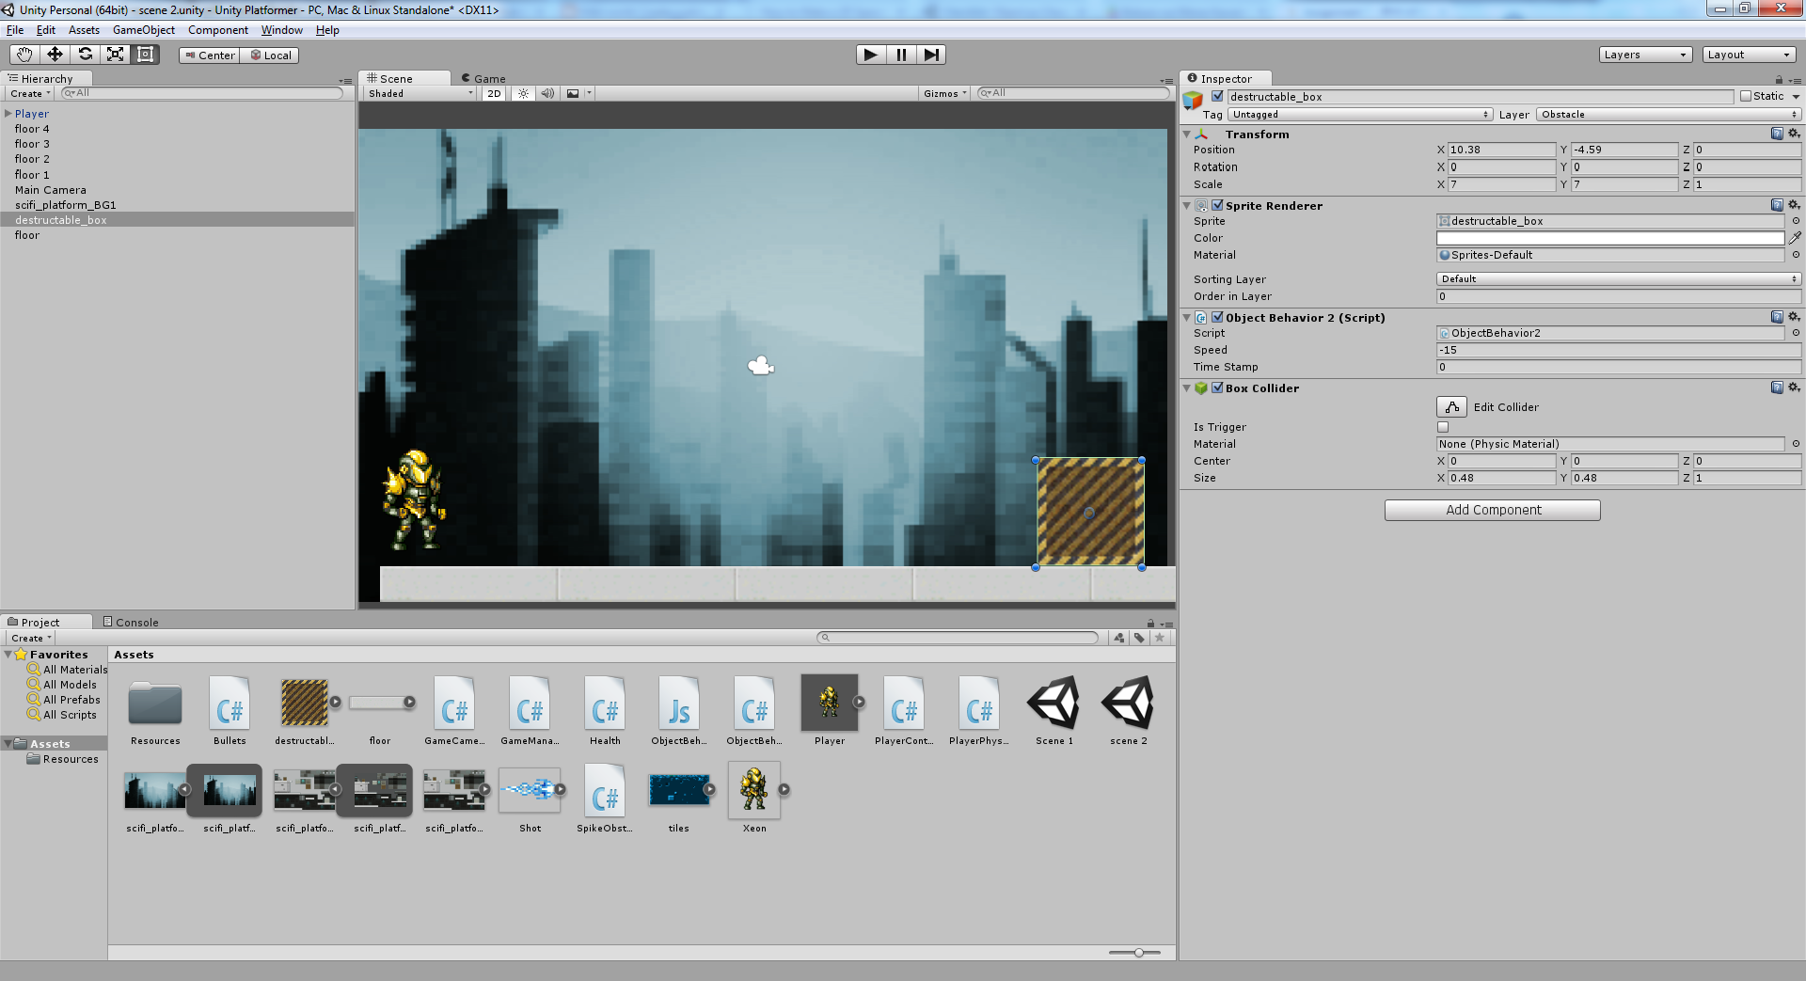
Environment Scripts
Created movement scripts for obstacles
Set Background

Slide 5
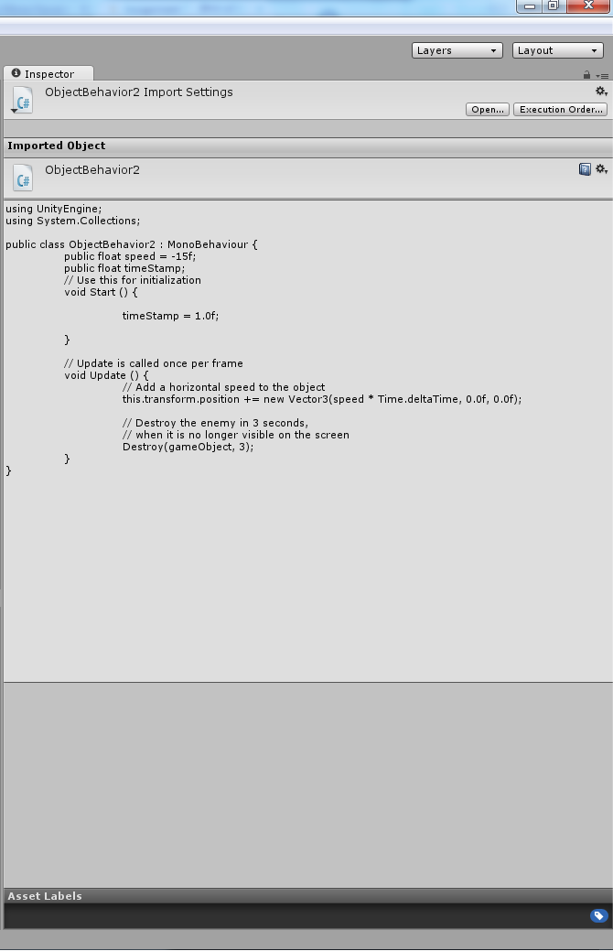
Environment Scripts

Slide 6
To-Dos
Object Spawn
Add collision effect on objects

Slide 7
Start Menu
Accomplishments:
Familiarized myself with a new software
Watched tutorials on how to make a main menu in Unity
Made a main menu with buttons

Slide 8
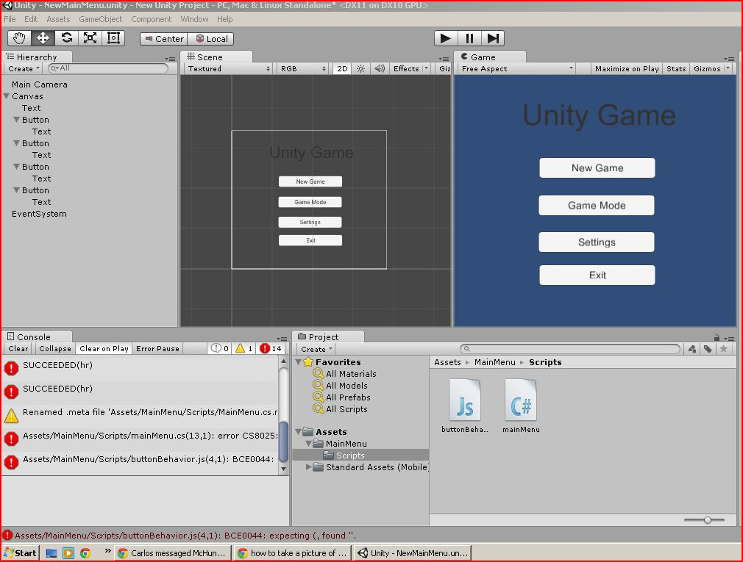

Slide 9
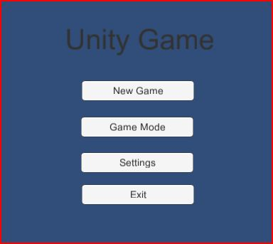

Slide 10
What’s next?
Incorporate menu with the game
Start scripting the buttons
Add backgrounds/texture

Slide 11
Enemy Sprites
Flying enemies:
Type 1:
Track enemy and fly in straight path
Collide and do damage
Otherwise destroyed on back wall
Type 2:
Zigzag up and down
Does not track player
Destroyed on back wall

Slide 12
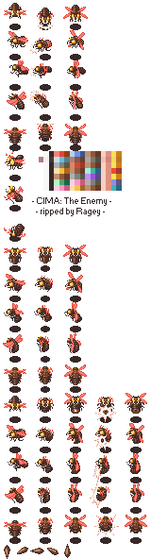
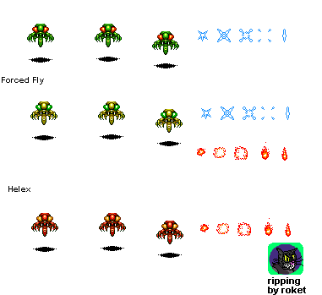
Type 2
Type 1

Slide 13
Enemy Sprites
Running enemies
Type 1:
1)Run at enemy player
2)Deal damage on collision
3)Destroyed on back wall
Type 2:
Fire at player in controlled burst
Possibility for boss
able to jump up and down
Moves backwards at the same speed as player
Shoots forward and can block player shots
Has own health bar explodes on 0 health

Slide 14
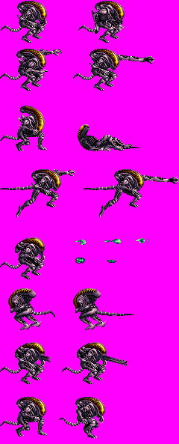
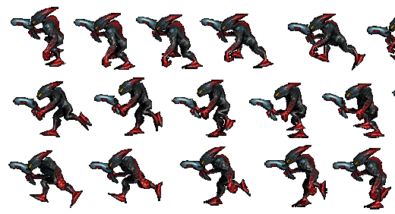
Type 2
Type 1

